Slide 1
Accent recognition
Made by:
Samuel Bismoth
Yehonata Sha’ag
Yishay Seroussi

Slide 2
Introduction
Recognize next accents: US, UK, Hebrew, Russian, French.
Data collected from YouTube.
Deep learning models: simple SoftMax, neural network (hidden layers), LSTM

Slide 3
DataSet
About 2 hours of each accent.
Divide to 5-10 sec.
Each segment transformed to mfcc.
The data was divide to train and test, 70/30 respectively

Slide 4
MODELS

Slide 5
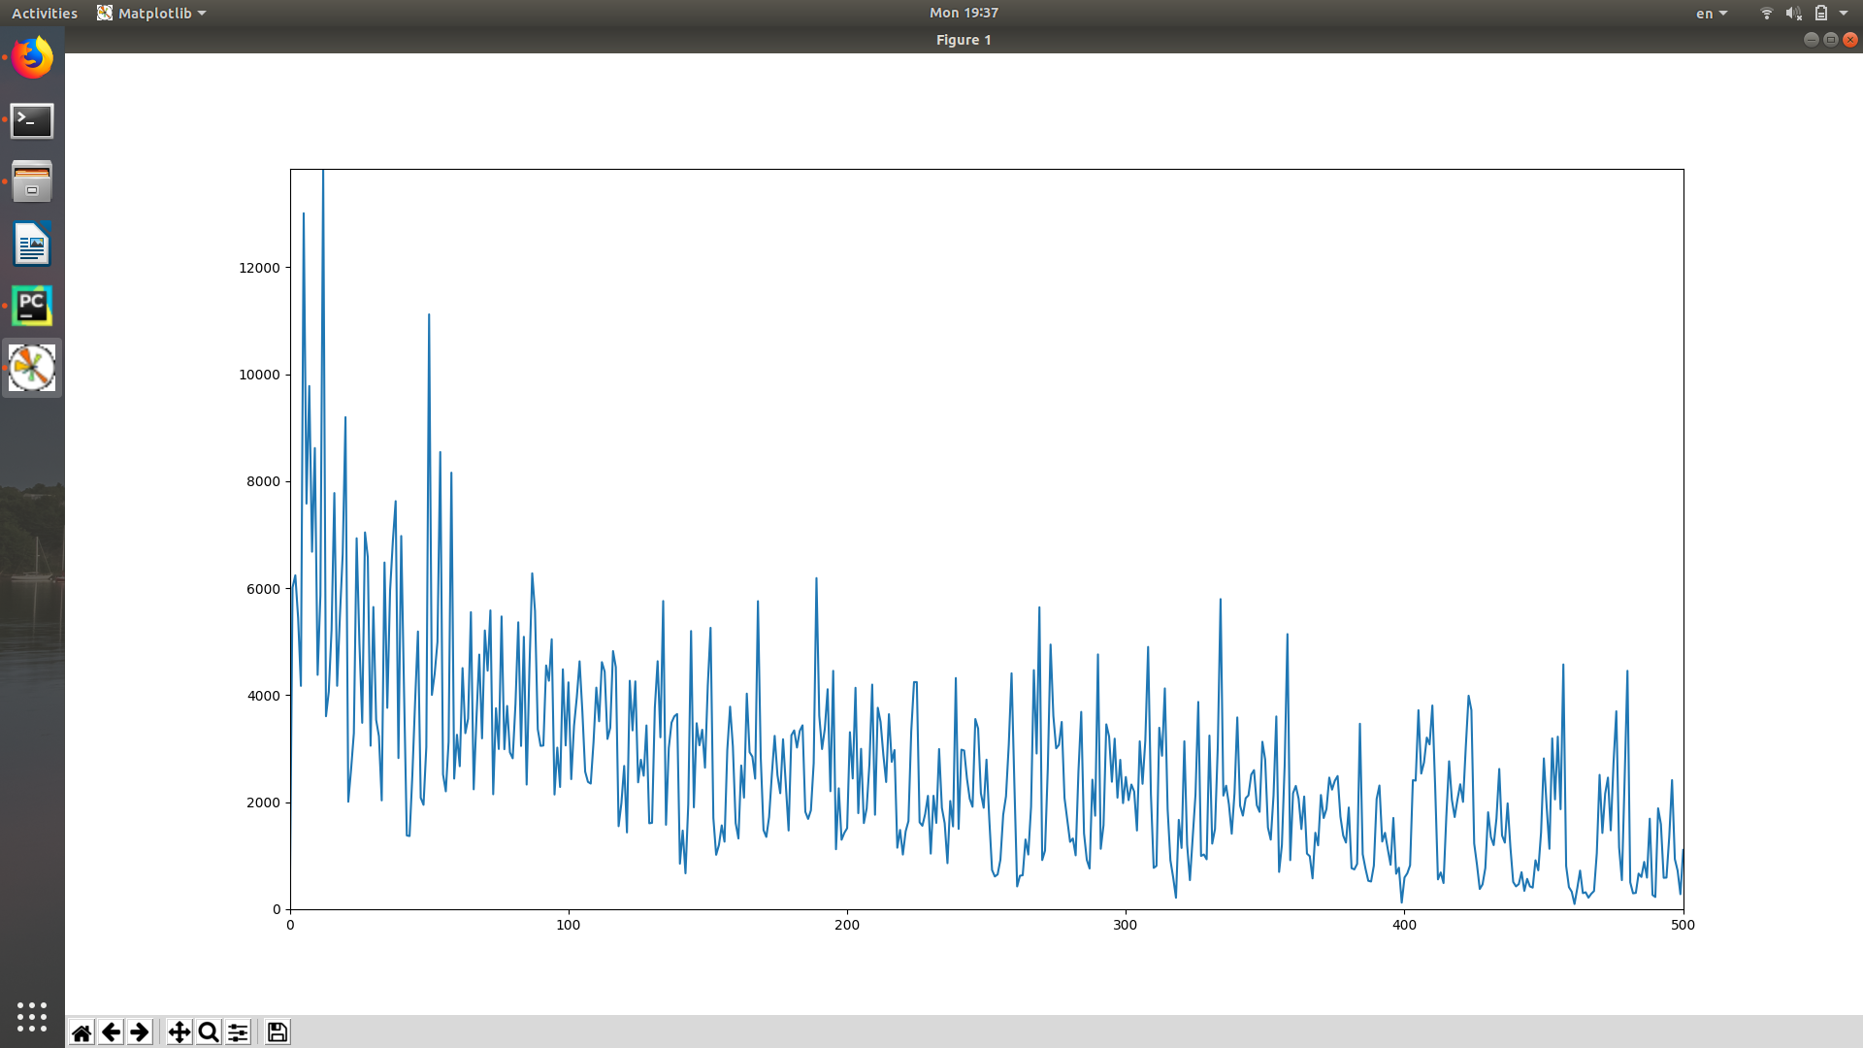
Step 1
SoftMax
On this model we reached test accuracy 50% .
And loss function was not very nice, as you can see

Slide 6
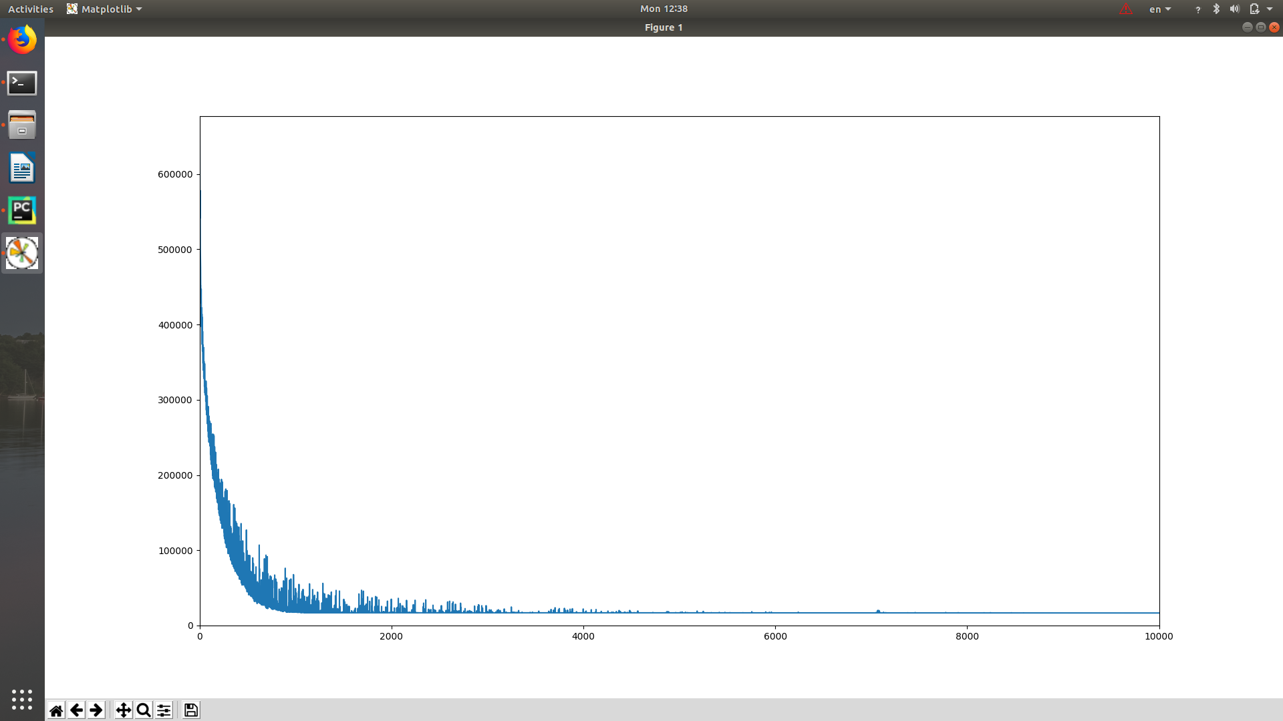
Step 2
HIDDEN LAYERS
On the next level we added new hidden layer.
Now we reached improve of 5%, and better loss function.

Slide 7
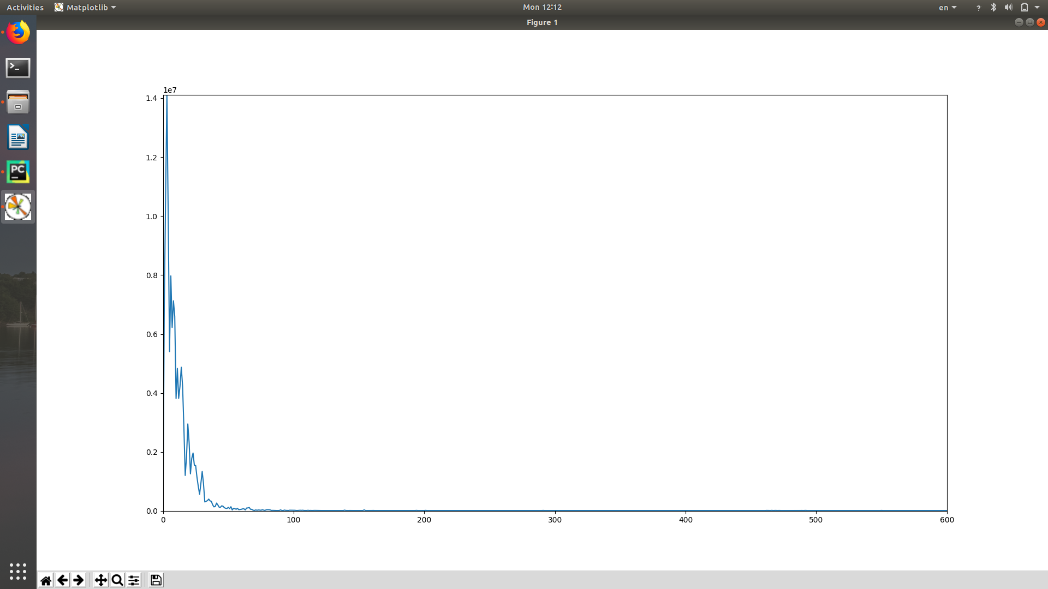
Step 3
HIDDEN LAYERS
At this point we add regularization.
We reached another improvement of 5%,
And the loss function:

Slide 8
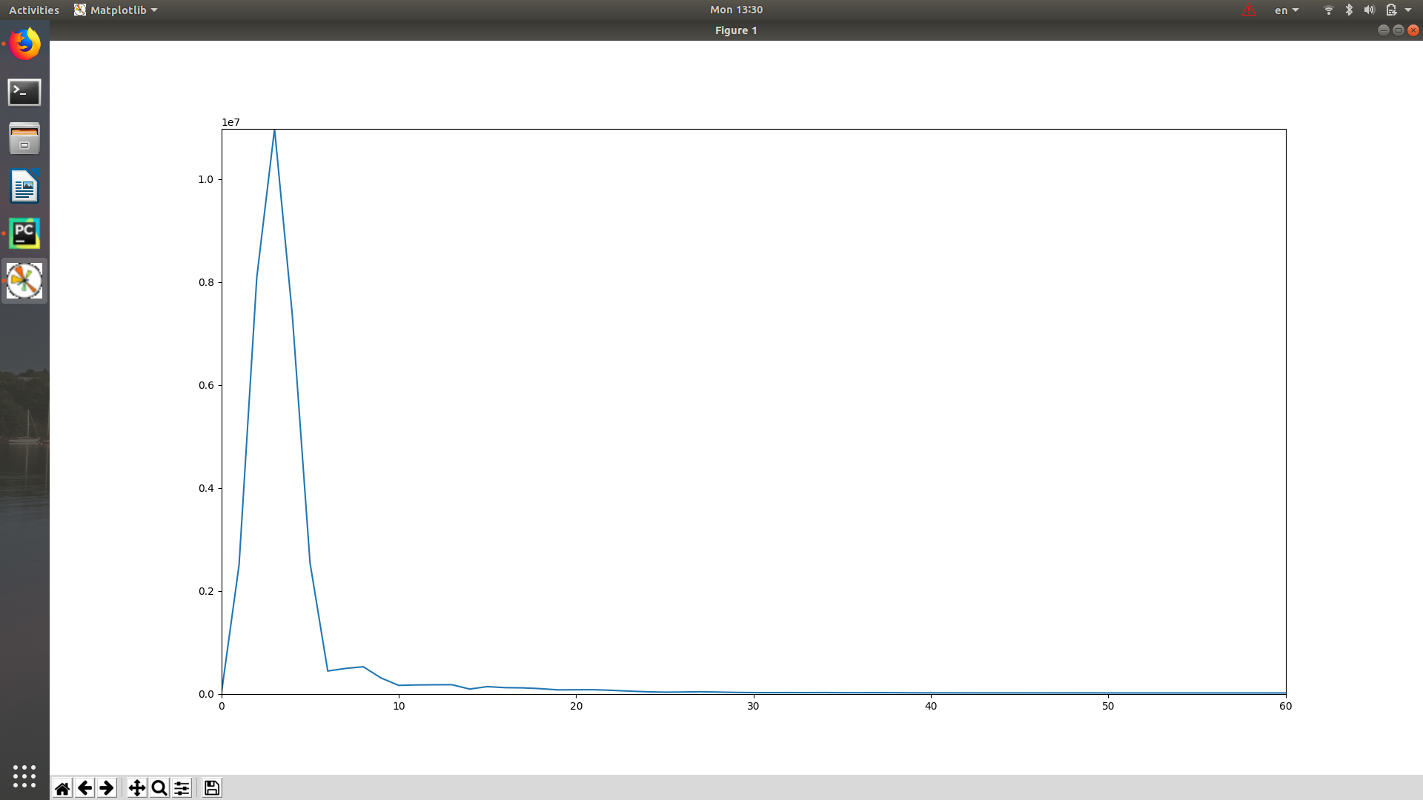
Step 3
HIDDEN LAYERS
Finally, we decide to add relu function to the hidden layer.
Now we reached great improvement, and our test accuracy grown to 75%.
And the loss function we got was better.
** At this point we used those parameters:
Learning rate = 0.05
Batch size = 600
Number of steps = 60
Number of hidden layers=2
Size of layer 1 = 256
Size of layer 2 = 256

Slide 9
Step 3
CNN
At this level we tried to implement CNN model.
Our model compound of 3 layers.
The first one: 32 filters of size 5x5, and MAXpool of size 2x2.
At the second layer: 64 filters of size 5x5x32, and MAXpool of size 2x2.
The layer was fully connected network (256 neurons in two layers).
This experiment didn’t go well. We achived only 28% on the test accuracy.

